Slide 1

Using Kubernetes to Manage All the Things
Modified from slides by
Shayan Sarkar | Booz Allen Hamilton
Will Patterson | Booz Allen Hamilton
Innovation center, Washington, D.C.

Slide 2
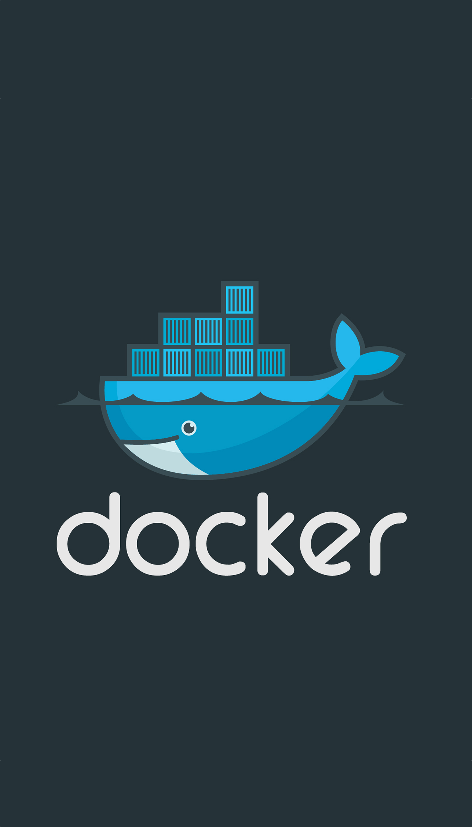
What has Docker Done for Us?
Continuous delivery
Deliver software more often and with less errors
No time spent on dev-to-ops handoffs
Improved Security
Containers help isolate each part of your system and provides better control of each component of your system
Run anything, anywhere
All languages, all databases, all operating systems
Any distribution, any cloud, any machine
Reproducibility
Reduces the times we say “it worked on my machine”

Slide 3
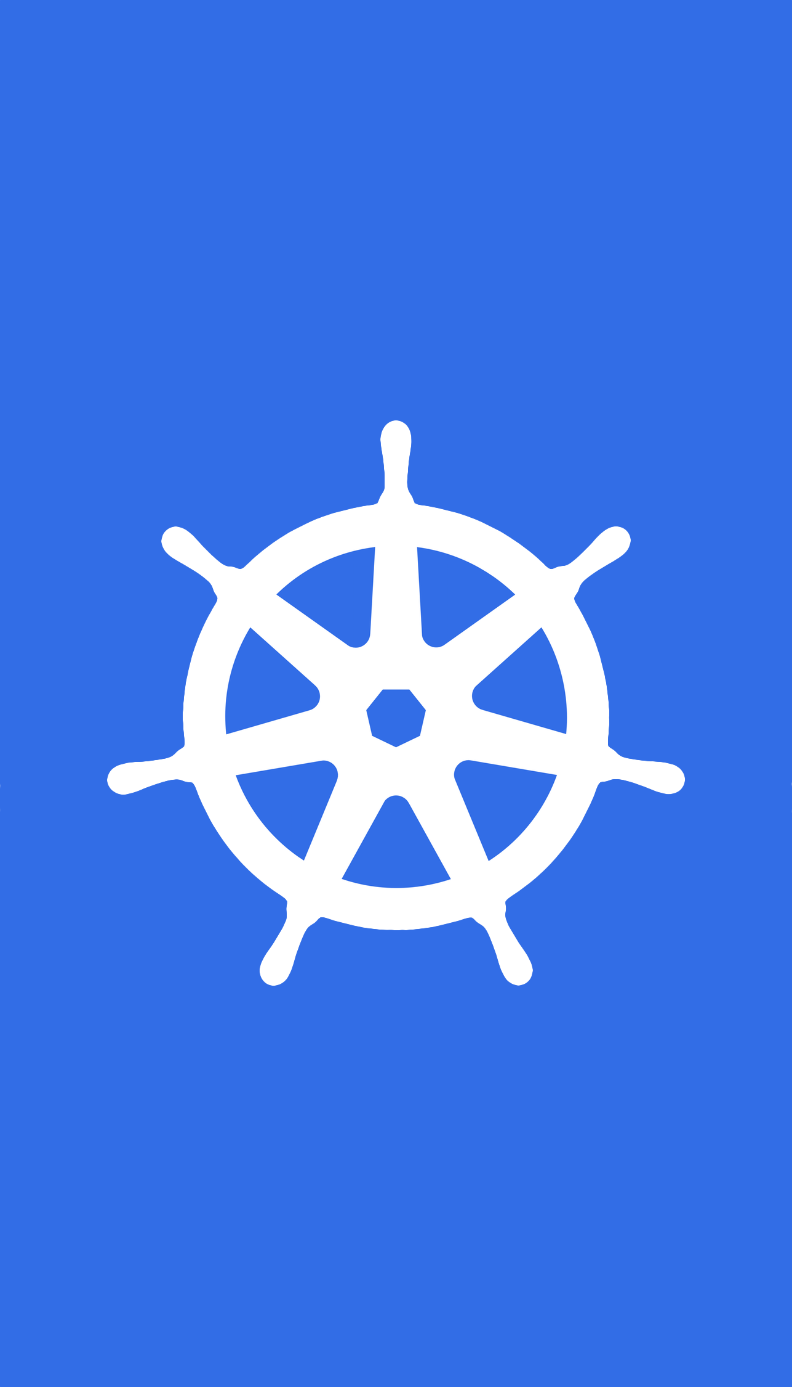
What Does Kubernetes do?
Kubernetes is an open-source system for automating deployment, scaling, and management of containerized applications.
Improves reliability
Continuously monitors and manages your containers
Will scale your application to handle changes in load
Better use of infrastructure resources
Helps reduce infrastructure requirements by gracefully scaling up and down your entire platform
Coordinates what containers run where and when across your system
How do all the different types of containers in a system talk to each other?
Easily coordinate deployments of your system
Which containers need to be deployed
Where should the containers be deployed

Slide 4
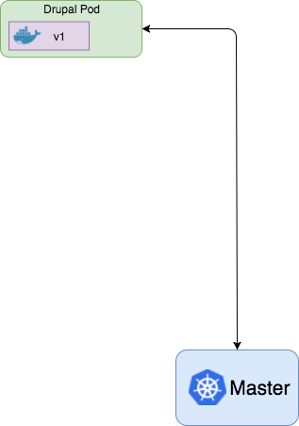
The Pod is the core Kubernetes Component
The Pod is the core component of Kubernetes
Collection of 1 or more containers
Each pod should focus on one container, however sidecar containers can be added to enhance features of the core container
spec: template: spec: containers: - name: drupal image: cr.io/repo/mydrupal:v1

Slide 5
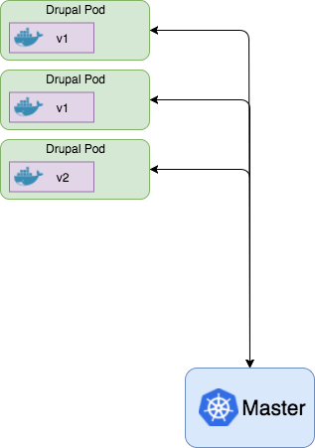
Pods can Handle Scaling and Deployments
Once Kubernetes understands what is in a pod, multiple management features are available:
System Performance
Scale up/down the number of pods based on CPU load or other criteria
System Monitoring
Probes to check the health of each pod
Any unhealthy ones get killed and new pod is put into service
Deployments
Deploy new versions of the container
Control traffic to the new pods to test the new version
Blue/Green deployments
Rolling deployments

Slide 6
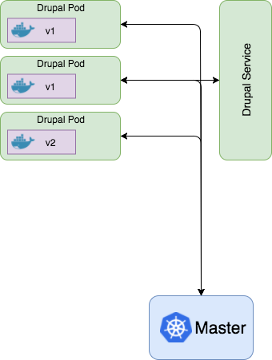
Kubernetes Services tie together the pods
Kubernetes Services are used to control communications with the pods
Load balance the requests
Don’t send traffic to the unhealthy ones
Only talk to the correct version
apiVersion: v1 kind: Service metadata: name: drupal spec: selector: app: drupal ports: - name: http-port port: 80 type: LoadBalancer

Slide 7
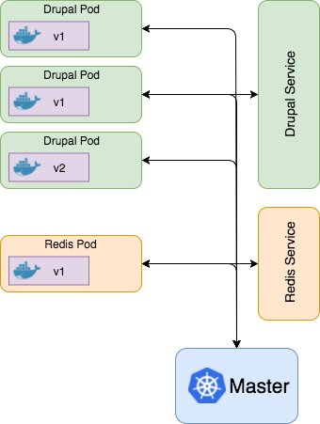
Services Structure allow multiple Components
With the Service architecture Kubernetes handles things that you often might have to worry about
Service discovery
Load balancing
Scaling
Service discovery allows each pod just needs to call the name of the service it wants to talk to
Services have multiple options
Session based load balancing
Single port based services
External Services
The Service architecture of Kubernetes can be scaled up to handle as many services as you would like for your system

Slide 8
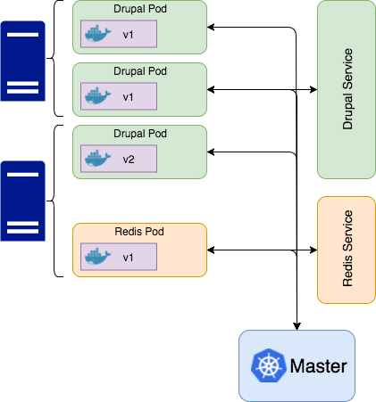
Where Is the Infrastructure?
You don’t have to worry about the infrastructure
The entire design of pods and services is described with YAML files
Nothing in deployments, pod management, service discovery, monitoring, etc required any knowledge about how many servers, IP addresses, load balancers, or anything else with the infrastructure
Behind the scenes, Kubernetes is aware of all of the servers available, load balancers, application gateways and will configure them automatically according to what is in the YAML files

Slide 9

Lessons Learned
Kubernetes is open source and fast moving. Cloud provider specific integrations might trail a couple versions.
Ingress Controllers
Managed Disks
While the Infrastructure is generally transparent, you still need to ensure that the cloud provider implemented Kubernetes support in a manner that meets your system needs
Internal vs External load balancers
Cluster Scaling
Leverage the strength of the open source community.
Notes:
Just as support for volumes differs between cloud providers,
The same is true for provisioning a network internal load balancer
and auto scaling a cluster
To make a long story short, Kubernetes releases a new version every 3 months with a slew of new functionality
Before jumping on the latest version, check that it works with your cloud provider
And if it doesn’t take a look at their git hub. They are moving just as quickly, and actively respond to questions and bugs
It really is an example of open source at it’s best, when you have Google, Amazon, and Microsoft all working on the same project.

Slide 10

Getting Started
Install local utilities: kubectl and minikube https://kubernetes.io/docs/tasks/tools/install-kubectl/
Checkout the Kubernetes docs https://kubernetes.io/docs/home/
Unified Logging with Fluentbit http://fluentbit.io/documentation/0.11/kubernetes/
Syslog, Docker, and Drupal https://github.com/BradJonesLLC/docker-drupal

